Slide 1


St. MARTINS ENGINEERING COLLEGE
UGC Autonomous
NBA & NAAC A+ ACCREDITED
Dhulapally, Secunderabad– 500100
Department of CSE(AI&ML)
Facial Expression Recognition Dataset
A Comprehensive Resource for Emotion Analysis and AI Development
Batch No: 05 (TNR-Size 24)
1. T.AKSHITHA (21K81A6655)
2. K.GAYATHRI (21K81A6623)
3. O.PRASHANTH (21K81A6635)
Under the Guidance of
Mr. KRANTHI KUMAR
ASST.PROFESSER
Department of CSE(AI&ML)

Slide 2
OUTLINE
Abstract
Introduction
Literature Survey
Existing System
Proposed System
Modules (Split –up)
References

Slide 3
ABSTRACT
Facial emotion analysis has gained significant interest in recent years due to its applications in various fields, including human-computer interaction, security, and psychological studies
These statistics underscore the importance of developing robust and reliable facial emotion analysis systems. Existing manual approaches to facial emotion analysis involve human observers interpreting facial expressions.
These methods are time-consuming and lack consistency, as different observers may interpret the same expression differently. Moreover, manual analysis is not scalable for large datasets or real-time applications.
The inherent biases and limitations of human observers highlight the need for more objective and scalable solutions to facial emotion analysis.
Machine learning (ML) presents a promising solution to the challenges faced by manual approaches.By training models on large datasets of facial expressions

Slide 4
INTRODUCTION
Facial recognition and detection are cutting-edge technologies revolutionizing how we interact with digital and physical environments .By analyzing and identifying unique facial features, these technologies enable automated identification, authentication, and surveillance in various applications.
These technologies utilize advanced algorithms to detect and analyze facial characteristics such as the distance between eyes, nose shape, and jawline structure.
Initially developed for security and law enforcement purposes, facial recognition has expanded into diverse fields including mobile devices, retail, and healthcare.
The process typically involves capturing facial images or video frames, extracting unique features, and matching them against a database of known faces.

Slide 5
INTRODUCTION
Applications range from unlocking smartphones and automated passport control to monitoring attendance and enhancing customer experiences in retail.
Challenges include accuracy under varying lighting conditions, pose variations, facial expressions, and potential biases in datasets used for training.
Advances in computer vision and artificial intelligence have accelerated the accuracy and adoption of facial recognition systems in recent years.
Facial recognition is poised to revolutionize industries by streamlining processes, enhancing security measures, and personalizing user experiences.
The technology's rapid evolution raises questions about data security, algorithmic transparency, and societal implications.

Slide 6
LITERATURE SURVEY
S. No | Author | Title | Year | Contributions
01 | ALEJANDRO GOMEZ | Emotion recognition and facial expression | 2017 | Convolutional Neural Networks
02 | DIVYA TYAGI | Facial expression recognition using hybrid approach | 2017 | Support Vector Machine CLASSIFER
03 | INDRAJANI SUTEDJA | Emotional expression Recognition | 2022 | Systematic literature review Using suited algorithms
04 | SUBHAM SHAH | Audio based facial expression | 2023 | Argumented reality technology
05 | DEEPAK RAJ | Facial expression recognition using CNN | 2023 | Image preprocessing features

Slide 7
EXISTING SYSTEM
Deep Learning Approaches:
Convolutional Neural Networks (CNNs):Used for feature extraction from facial images, highly effective in classifying emotions.
Pre-trained Models Such as VGG-Face, Res-Net, and Inception networks fine-tuned for emotion recognition
Emotion Recognition Datasets:
FER-2013: A large dataset of facial expressions labeled with basic emotions.
Affect Net: Contains a diverse set of facial expressions with seven emotion labels..
Real-Time Emotion Detection:
OpenCV Integration: Used for real-time face detection and emotion classification.
Mobile and Web Applications: Platforms like Affective and Face Reader offer real-time emotion recognition
Hybrid Models
Combine facial expression data with other inputs such as voice or body language for more accurate emotion recognition.

Slide 8
PROPOSED SYSTEM
FACE EMOTION EXPRESSION DATABASE:
A face emotion expression database is a collection of images or video clips with facial expressions of a range of emotions. These databases are essential for training, testing, and validation of algorithms
IMAGE PREPROCESSING:
Image preprocessing is a crucial step in computer vision and image analysis. It involves modifying the images to prepare them for further processing or analysis.
AI MODEL TRAINING:
To train an AI model for face emotion expression recognition, you can use a deep learning approach, specifically Convolutional Neural Networks (CNNs).

Slide 9
PERFORMANCE ESTIMATION:
Performance estimation is a crucial step in evaluating the effectiveness of a machine learning model. Here are some common metrics used to estimate the performance of a face emotion expression recognition model
TEST FACIAL EXPRESSION:
To test facial expressions, you can use various databases and tools. There are several face emotion expression databases available, such as the Nim Stim set of facial expressions, FACES stimulus set
.

Slide 10
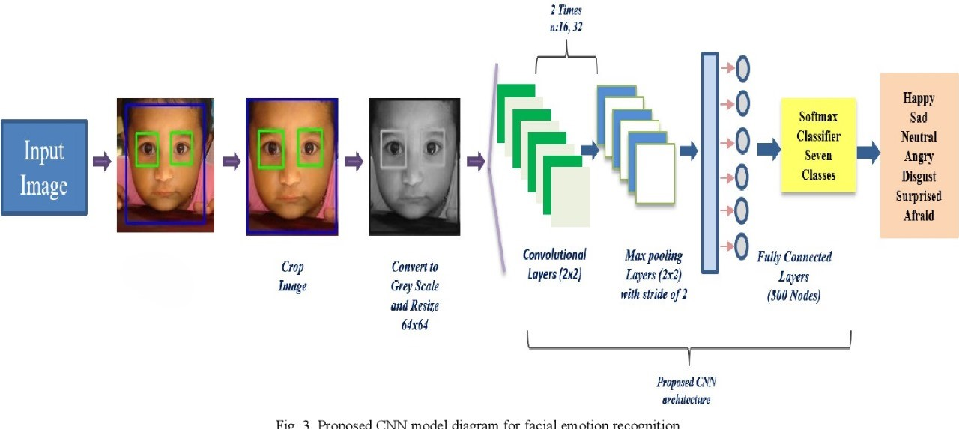

Slide 11
MODULES (SPLIT – UP)
FACE EMOTION EXPRESSION DATABASE
IMAGE PREPROCESSING
AI MODEL TRAINING
PERFORMANCE ESTIMATION
TEST FACIAL EXPRESSION
OUTPUT FACE EMOTION

Slide 12
REFERENCES
FER-2013: A Large-Scale Dataset for Facial Emotion Recognition" by J. M. A. De la Torre, T. Zhang, and others (2013)
"Emotion Recognition from Facial Expressions using Deep Learning Techniques" by J. A. Gonzalez, M. S. Gupta, and others (2021)
Deep Face: Closing the Gap to Human-Level Performance in Face Verification" by Yaniv Taigman, Ming Yang, and others (2014)
"Facial Expression Recognition Using Deep Learning" by Y. Liu, M. M. K. Naidu, and others (2019)
A Survey on Facial Emotion Recognition with Deep Learning" by Zhiwei Zhang, Yunchao Wei, and others (2020).

Slide 13
REFERENCES
Mateusz Zarkowski Identification Emotion Recognition System for a Social Robot IEEE Posted: 2013Crossref 72.
M Pantic, A Pentland, A Nijholt, TS Huang Human computing and machine understanding of human behaviour: a survey, in Artificial Intelligence for Human Computing Lecture, volume 4451
H K Meena, K K Sharma, S D Joshi Improved facial expression recognition using graph signal processing Electronics
T ahsan , T Jabia , U.-P Chong Facial expression recognition using local transitional pattern on Gabor Filtered facial image

Slide 14
THANK YOU

